Slide 1
Skyland Strike
By: Logan Boyer

Slide 2
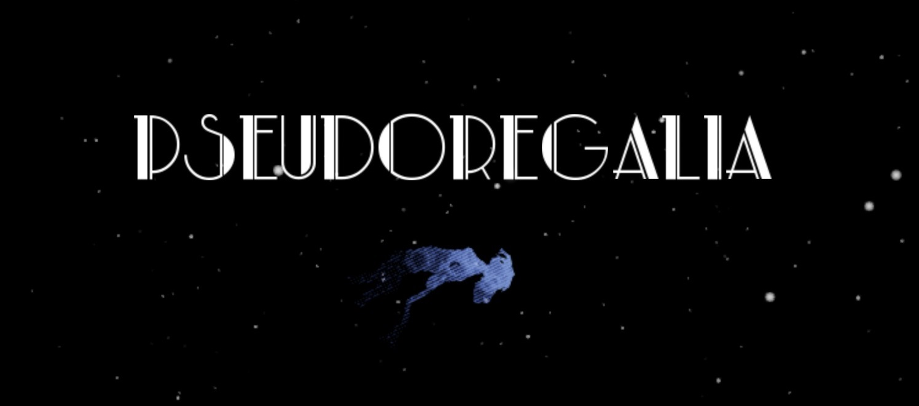
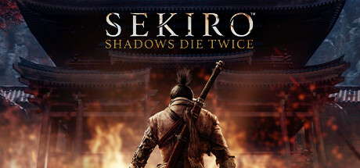
Inspiration

Slide 3
Overview
Combination of Puzzle solving and hack-and-slash
Implement similar movement as Pseudoregalia
Combat mix of Sekiro and Pseudoregalia
  Simple slashing from Pseudoregalia
  Parry and “death blows” from Sekiro
Low polygon design similar to Pseudoregalia or Super Mario 64
Basic “Good vs. Evil” plot line
Skill Tree based on Constellations

Slide 4
Backstory
“In the beginning, there was nothing. And then, there was something!”
Yadda yadda good and evil imbalance in the Skylands, Evil creatures invading, headed by some big bad that stands in as the bosses
“As if sent down by the gods themselves, [main character name here] descended from the stars…”
Style of Moving visual novel/digital caligraphy

Slide 5
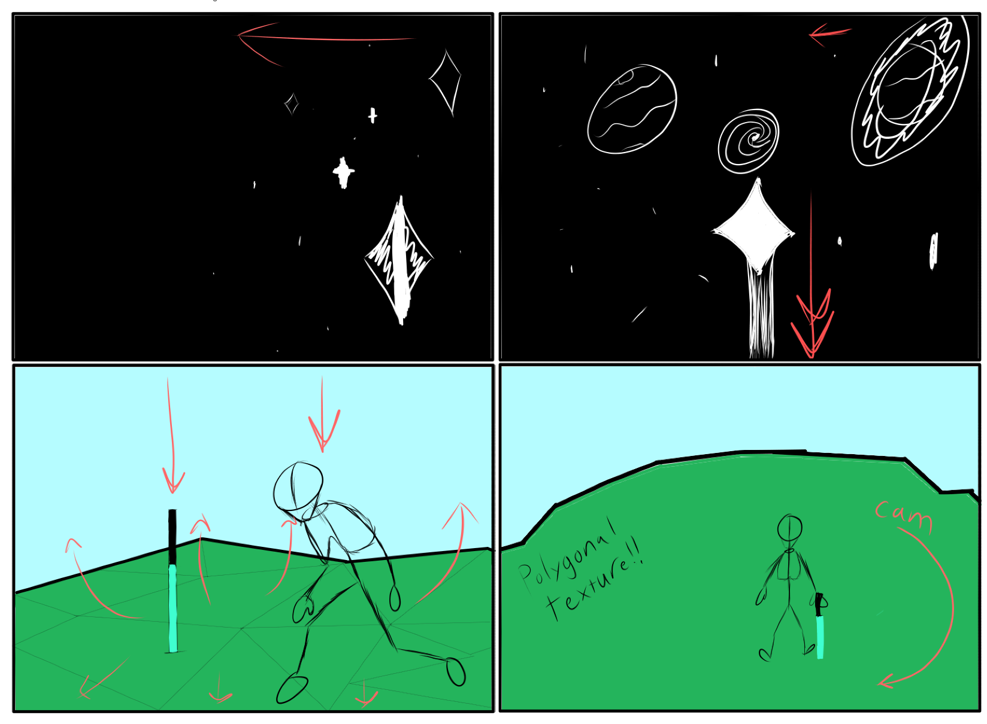
Opening Scene

Slide 6
Timeline
Week long sprints
Week 1 – level design, Puzzle creation!
Week 2 – Level texture and decoration
Week 3 – Create Player and work on Movement
Week 4 – Create enemies + behavior scripts
Week 5 – Player and Enemy Animations
Week 6 – Combat
Week 7 – Cutscenes and Polish!

Slide 7
Estimate for final product
3 Years

Slide 8
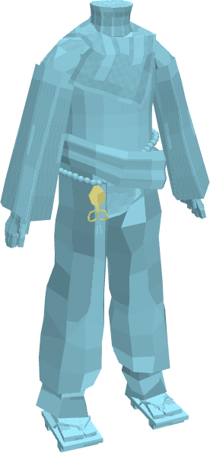
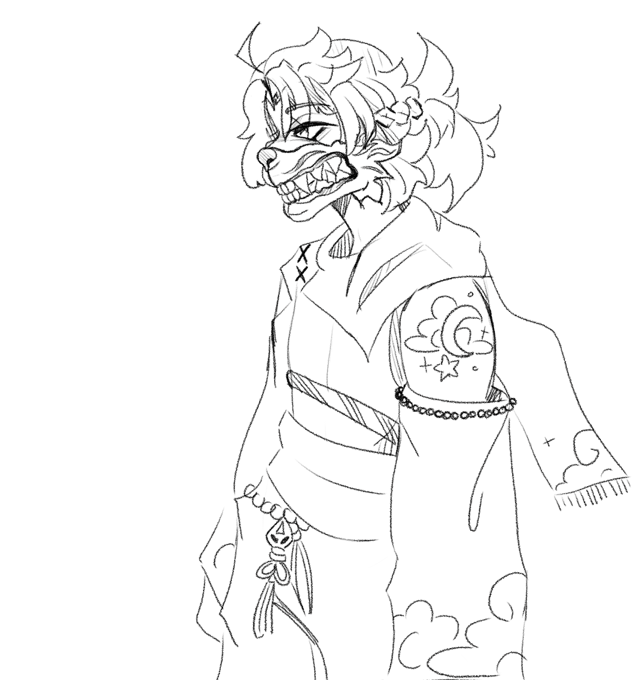
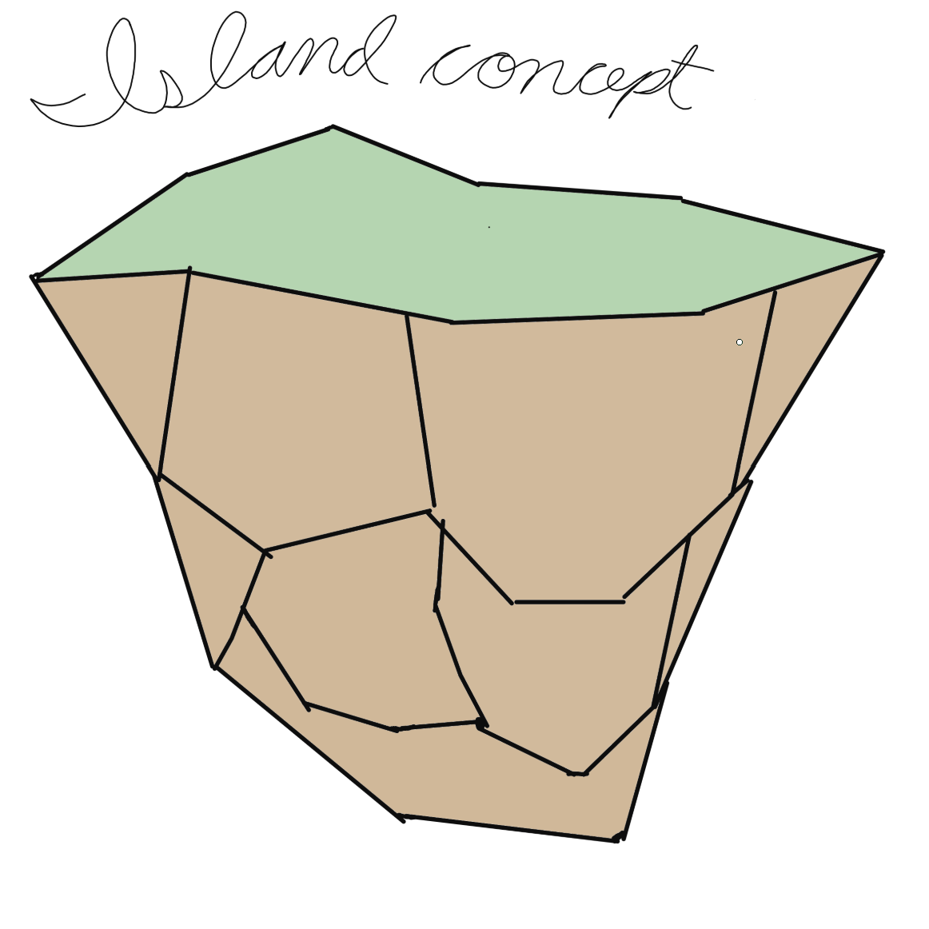
Current Progress
Thanks, Best Buy!

Slide 9
Game Design document

